Slide 1
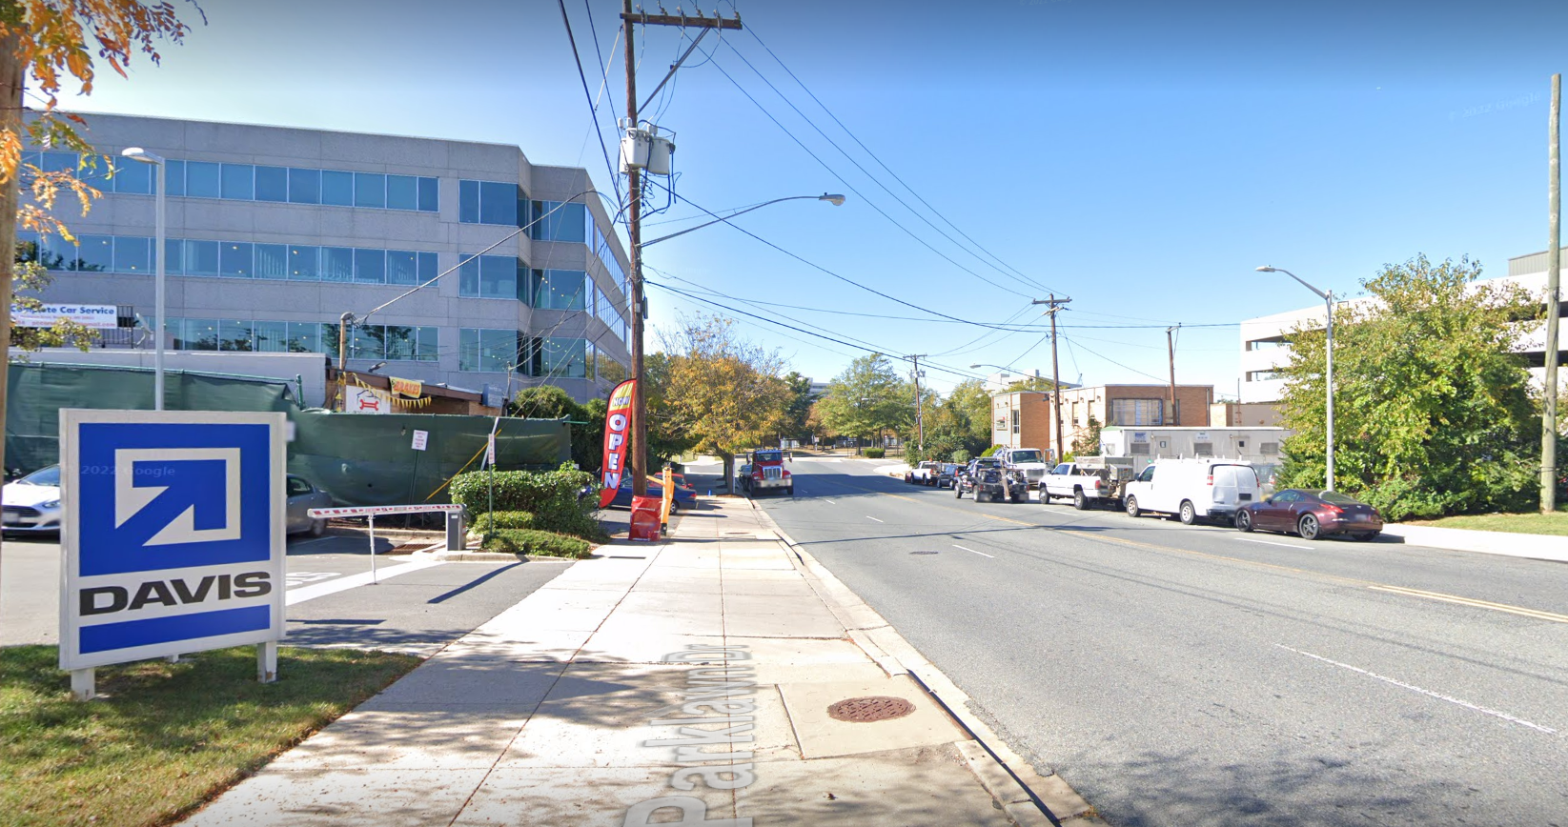
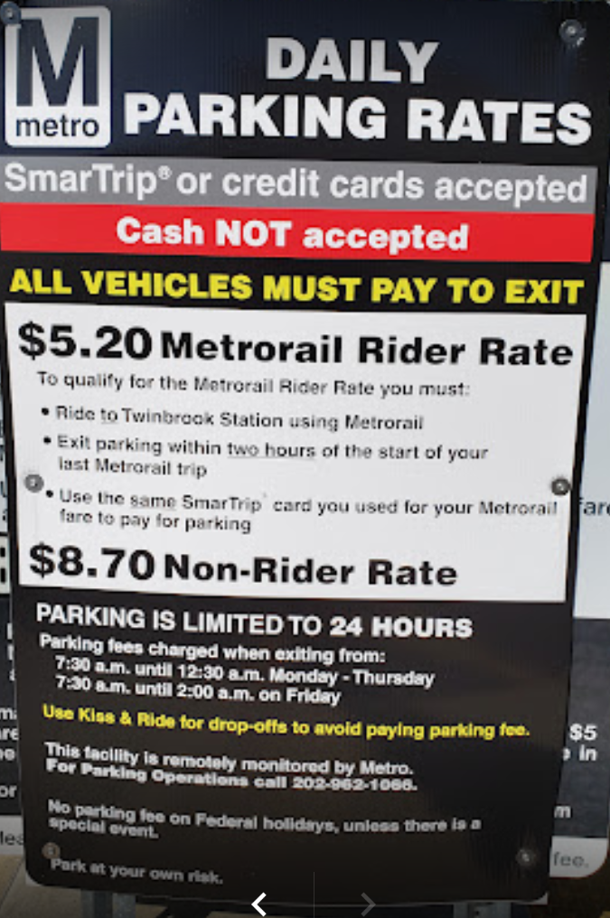
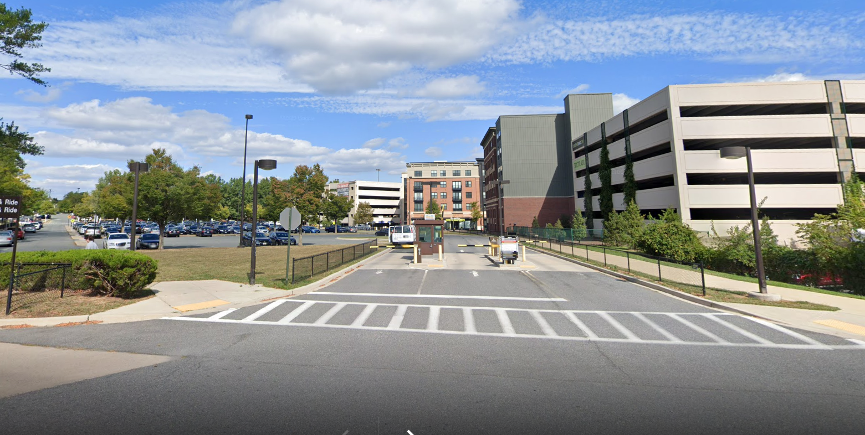
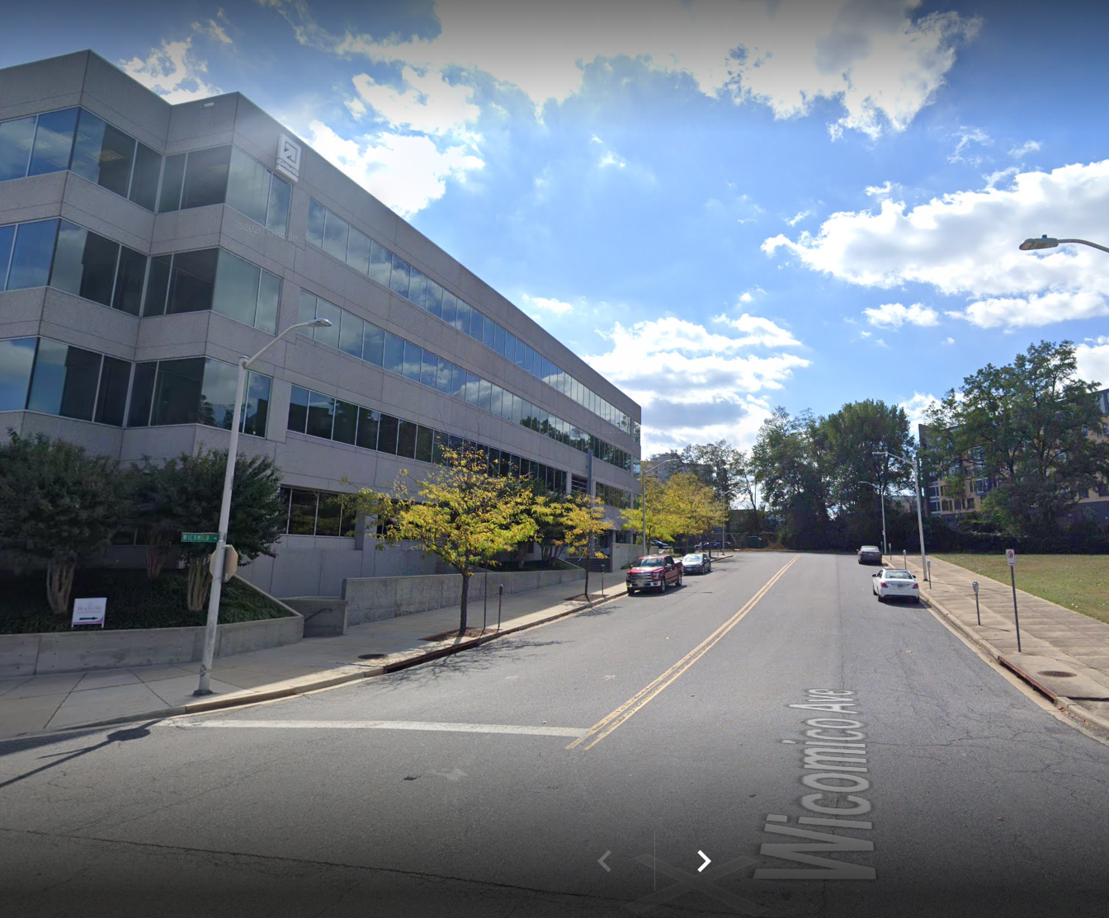
After turning on Parklawn Drive go past our building which will be on your left and turn right into the Metro parking lot just before reaching the Metro station. After parking your car, carefully walk across the street and enter our building from the Metro side of the building.
DAVIS HQ Entrance on other side of building
Parklawn Drive
DAVIS HQ Metro side of building
Enter Here
To Metro Parking
Walk to building entrance
across the street from Metro parking

